Slide 1


Information Parents Can Use
An eBrochure Series
Georgia Career Information Center

Slide 2



Information Parents Can Use
An e-Brochure series that enables parents to become involved in their student’s career decision-making process.
Notes:
Falling pictures
(Intermediate)
To reproduce the picture effects on this slide, do the following:
On the Home tab, in the Slides group, click Layout, and then click Blank.
On the Insert tab, in the Illustrations group, click Picture.
In the Insert Picture dialog box, select a picture, and then click Insert.
Select the picture. Under Picture Tools, on the Format tab, in the bottom right corner of the Size group, click the Size and Position dialog box launcher. In the Size and Position dialog box, on the Size tab, resize or crop the picture as needed so that under Size and rotate, the Height box is set to 2.93” and the Width box is set to 4.41”. Resize the picture under Size and rotate by entering values into the Height and Width boxes. Crop the picture under Crop from by entering values into the Left, Right, Top, and Bottom boxes.
Under Picture Tools, on the Format tab, in the Picture Styles group, click More, and then click Beveled Matte, White (first row, second option from the left).
Under Picture Tools, on the Format tab, in the bottom right corner of the Size group, click the Size and Position dialog box launcher. In the Size and Position dialog box, on the Size tab, under Size and rotate, in the Rotation box, enter 5°.
Under Picture Tools, on the Format tab, in the bottom right corner of the Picture Styles group, click the Format Picture dialog box launcher. In the Format Picture dialog box, in the left pane, click Shadow. In the Shadow pane, click the button next to Presets, and then under Outer click Offset Diagonal Bottom Left (first row, third option from the left). In the Distance box, enter 20 pt.
Drag the picture into the top right corner of the slide.
Select the picture. On the Home tab, in the Clipboard group, click the arrow under Paste, and then click Duplicate.
Drag the second (duplicate) picture to the left middle of the slide.
Select the second picture. Under Picture Tools, on the Format tab, in the bottom right corner of the Size group, click the Size and Position dialog box launcher. In the Size and Position dialog box, on the Size tab, under Size and rotation, in the Rotation box, enter 0°.
Right-click the second picture and click Change Picture.
In the Insert Picture dialog box, select a picture, and then click Insert.
Select the second picture. Under Picture Tools, on the Format tab, in the bottom right corner of the Size group, click the Size and Position dialog box launcher. In the Size and Position dialog box, on the Size tab, resize or crop the picture as needed so that under Size and rotate, the Height box is set to 2.93” and the Width box is set to 4.41”. Resize the picture under Size and rotate by entering values into the Height and Width boxes. Crop the picture under Crop from by entering values into the Left, Right, Top, and Bottom boxes.
Under Picture Tools, on the Format tab, in the bottom right corner of the Picture Styles group, click the Format Picture dialog box launcher. In the Format Picture dialog box, in the left pane, click 3-D Rotation. In the 3-D Rotation pane, click the button next to Presets, under Perspective click Perspective Relaxed (second row, third option from the left), and then do the following:
In the X box, enter 0°.
In the Y box, enter 320°.
In the Z box, enter 10°.
In the Perspective box, enter 80°.
On the Home tab, in the Drawing group, click Arrange, and then click Send to Back.
Select the second picture. On the Home tab, in the Clipboard group, click the arrow under Paste, and then click Duplicate.
Drag the third picture to the bottom right corner of the slide, under the first picture.
Right-click the third picture and click Change Picture. In the Insert Picture dialog box, select a picture, and then click Insert.
Select the third picture. Under Picture Tools, on the Format tab, in the bottom right corner of the Size group, click the Size and Position dialog box launcher. In the Size and Position dialog box, on the Size tab, resize or crop the picture as needed so that under Size and rotate, the Height box is set to 2.93” and the Width box is set to 4.41”. Resize the picture under Size and rotate by entering values into the Height and Width boxes. Crop the picture under Crop from by entering values into the Left, Right, Top, and Bottom boxes.
Under Picture Tools, on the Format tab, in the bottom right corner of the Picture Styles group, click the Format Shape dialog box launcher. In the Format Picture dialog box, in the left pane, click 3-D Rotation. In the 3-D Rotation pane, click the button next to Presets, under Perspective click Perspective Relaxed (second row, third option from the left), and then do the following:
In the X box, enter 0°.
In the Y box, enter 300°.
In the Z box, enter 0°.
In the Perspective box, enter 60°.
On the Home tab, in the Drawing group, click Arrange, and then click Send to Back.
To reproduce the background effects on this slide, do the following:
Right-click the slide background area, and then click Format Background. In the Format Background dialog box, click Fill in the left pane, select Gradient fill in the Fill pane, and then do the following:
In the Type list, select Linear.
Click the button next to Direction, and then click Linear Down (first row, second option from the left).
Under Gradient stops, click Add or Remove until two stops appear in the drop-down list.
Also under Gradient stops, customize the gradient stops that you added as follows:
Select Stop 1 from the list, and then do the following:
In the Stop position box, enter 70%.
Click the button next to Color, and then click Black, Text 1, Lighter 5% (sixth row, second option from the left).
Select Stop 2 from the list, and then do the following:
In the Stop position box, enter 100%.
Click the button next to Color, click More Colors, and then in the Colors dialog box, on the Custom tab, enter values for Red: 87, Green: 78, Blue: 51.

Slide 3
Information Parents Can Use eBrochure Series
After High School, What Next?
Career Decision-Making
Special Populations
Going to High School
Financial Aid
Going to Middle School
Graduating from High School
BRIDGE Act
Downloadable eBrochure available
in English and Spanish at www.gcic.peachnet.edu

Slide 4

Going to Middle School
Ease your student’s transition to middle school by finding answers to frequently asked questions.
Downloadable eBrochure available
in English and Spanish at www.gcic.peachnet.edu

Slide 5
Going to High School
Find tips and answers to frequently asked questions to prepare your student for their transition to high school.
Downloadable eBrochure available
in English and Spanish at www.gcic.peachnet.edu

Slide 6

BRIDGE Act
Georgia’s BRIDGE Act is designed to help 6th – 12th grade students in public schools reach their career goals.
These state mandated, grade specific activities designed to:
Improve high school graduation rates
Improve student preparedness for postsecondary education
Improve student preparedness for careers
Involve students and parents in the education process
Downloadable eBrochure available
in English and Spanish at www.gcic.peachnet.edu

Slide 7

Graduating from High School
Students are eager to graduate from high school and move on to the next part of their lives. Learn about the current and future graduation requirements.
Downloadable eBrochure available
in English and Spanish at www.gcic.peachnet.edu

Slide 8
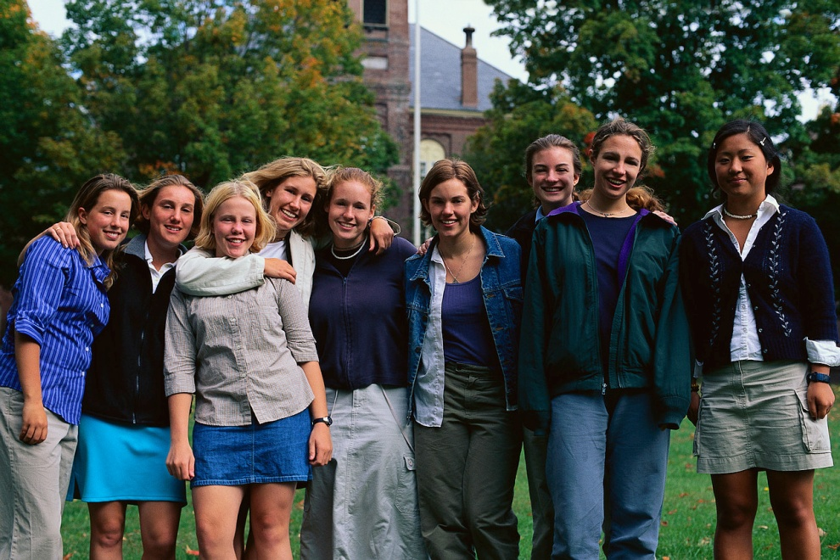
Special Populations
Special populations are not limited to students that have mental or physical disabilities, but also include students who are in need of guidance and assistance in order to complete high school.
Downloadable eBrochure available
in English and Spanish at www.gcic.peachnet.edu

Slide 9

After High School, What Next?
Explore five options to consider after high school
  Work
  Join the military
  Attend postsecondary school
  Apprenticeship
  Volunteer
Downloadable eBrochure available
in English and Spanish at www.gcic.peachnet.edu

Slide 10

Financial Aid
Each year, millions of college students apply for and receive financial aid. The money is out there if you know where to look.
Downloadable eBrochure available
in English and Spanish at www.gcic.peachnet.edu

Slide 11

Career Decision-Making
Making career decisions is a lifelong process. It begins with you, your awareness of the world, and your ability to understand what is important to you.
Downloadable eBrochure available
in English and Spanish at www.gcic.peachnet.edu

Slide 12

Information Parents Can Use
The Information Parents Can Use eBrochure series is available for download in English and Spanish at www.gcic.peachnet.edu.
Downloadable eBrochure available
in English and Spanish at www.gcic.peachnet.edu

Slide 13
Information Parents Can Use
••••••••••••••••••••••••••••••••••
Georgia Career Information Center
••••••••••••••••••••••••••••••••••
www.gcic.peachnet.edu
••••••••••••••••••••••••••••••••••

